Slide 1
Environmental Coordination in Idaho
Quarterly Meetings with funding agencies
SRF, HUD-CDBG, Corps of Engineers
Identify a lead agency for co-funded projects
Lead Agency would be the consultants main contact
Other Agency’s adopt or at a minimum use the information
Helps keep the team in front of any developing issues
Scoping meetings
Held early in the process
Joint training sessions for applicants and consultants
Continually work with other Agency’s to streamline (new regulations = new opportunities)
Include project team on all correspondence (keeps the project between the guardrails)

Slide 2
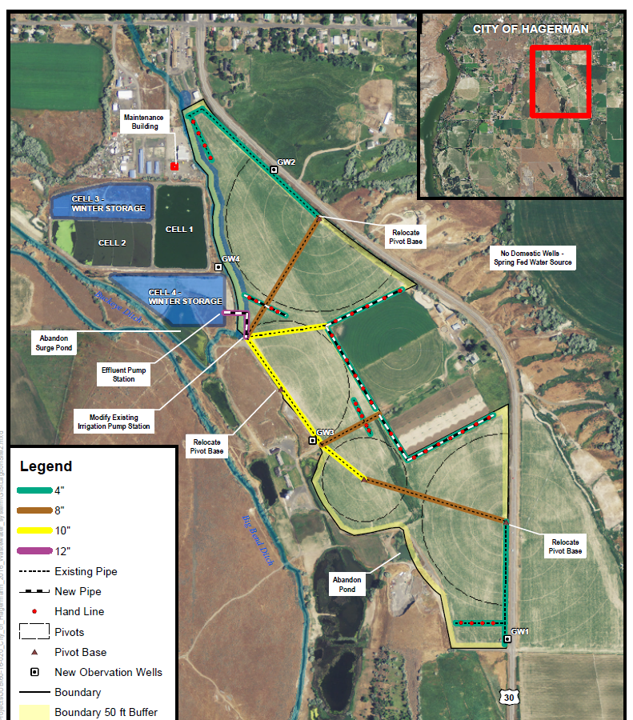
Joint Environmental Examples and Case Studies
City of Hagerman
New winter storage lagoon
All agencies involved at start of project
Held Scoping Meeting up front
City went with all funding Agencies
Determinations –
SRF - Cat Ex with supporting doc
RD - Cat Ex with Environmental Report
HUD-CDBG - Categorical Exclusion
Corps - EA/FONSI
Supporting documents were the same
Cost savings due to shared resources and documentation

Slide 3
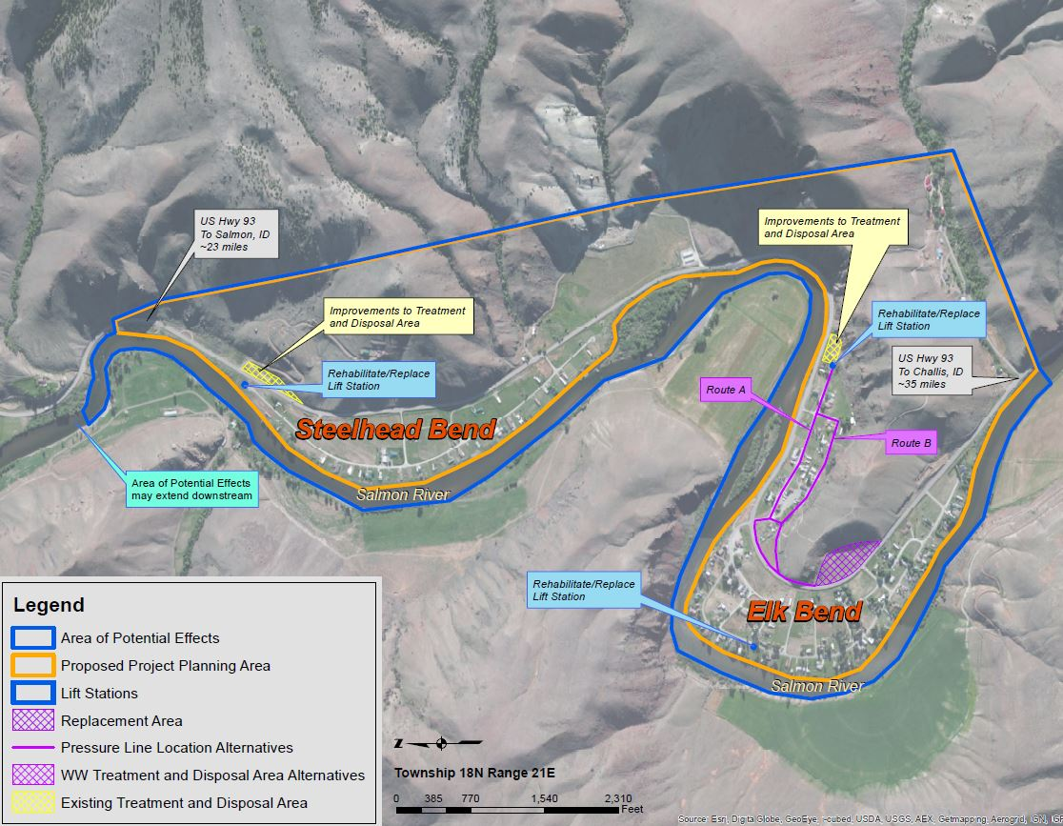
Joint Environmental Examples and Case Studies
Elk Bend Sewer District
Recirculating filter and LSAS
Only 2 agencies involved at start of project
SRF conducted initial resource agency consultations
RD used agency consultations to comply with our reg
Corps of Engineers came in late (cost overrun), used the same environmental documentation saving time
Determinations –
SRF – EA/FONSI (Planning only)
RD - Cat Ex with Environmental Report
HUD-CDBG
Corps – EA/FONSI
Same documentation used by all Agencies
Cost savings - shared resources and documentation

Slide 4
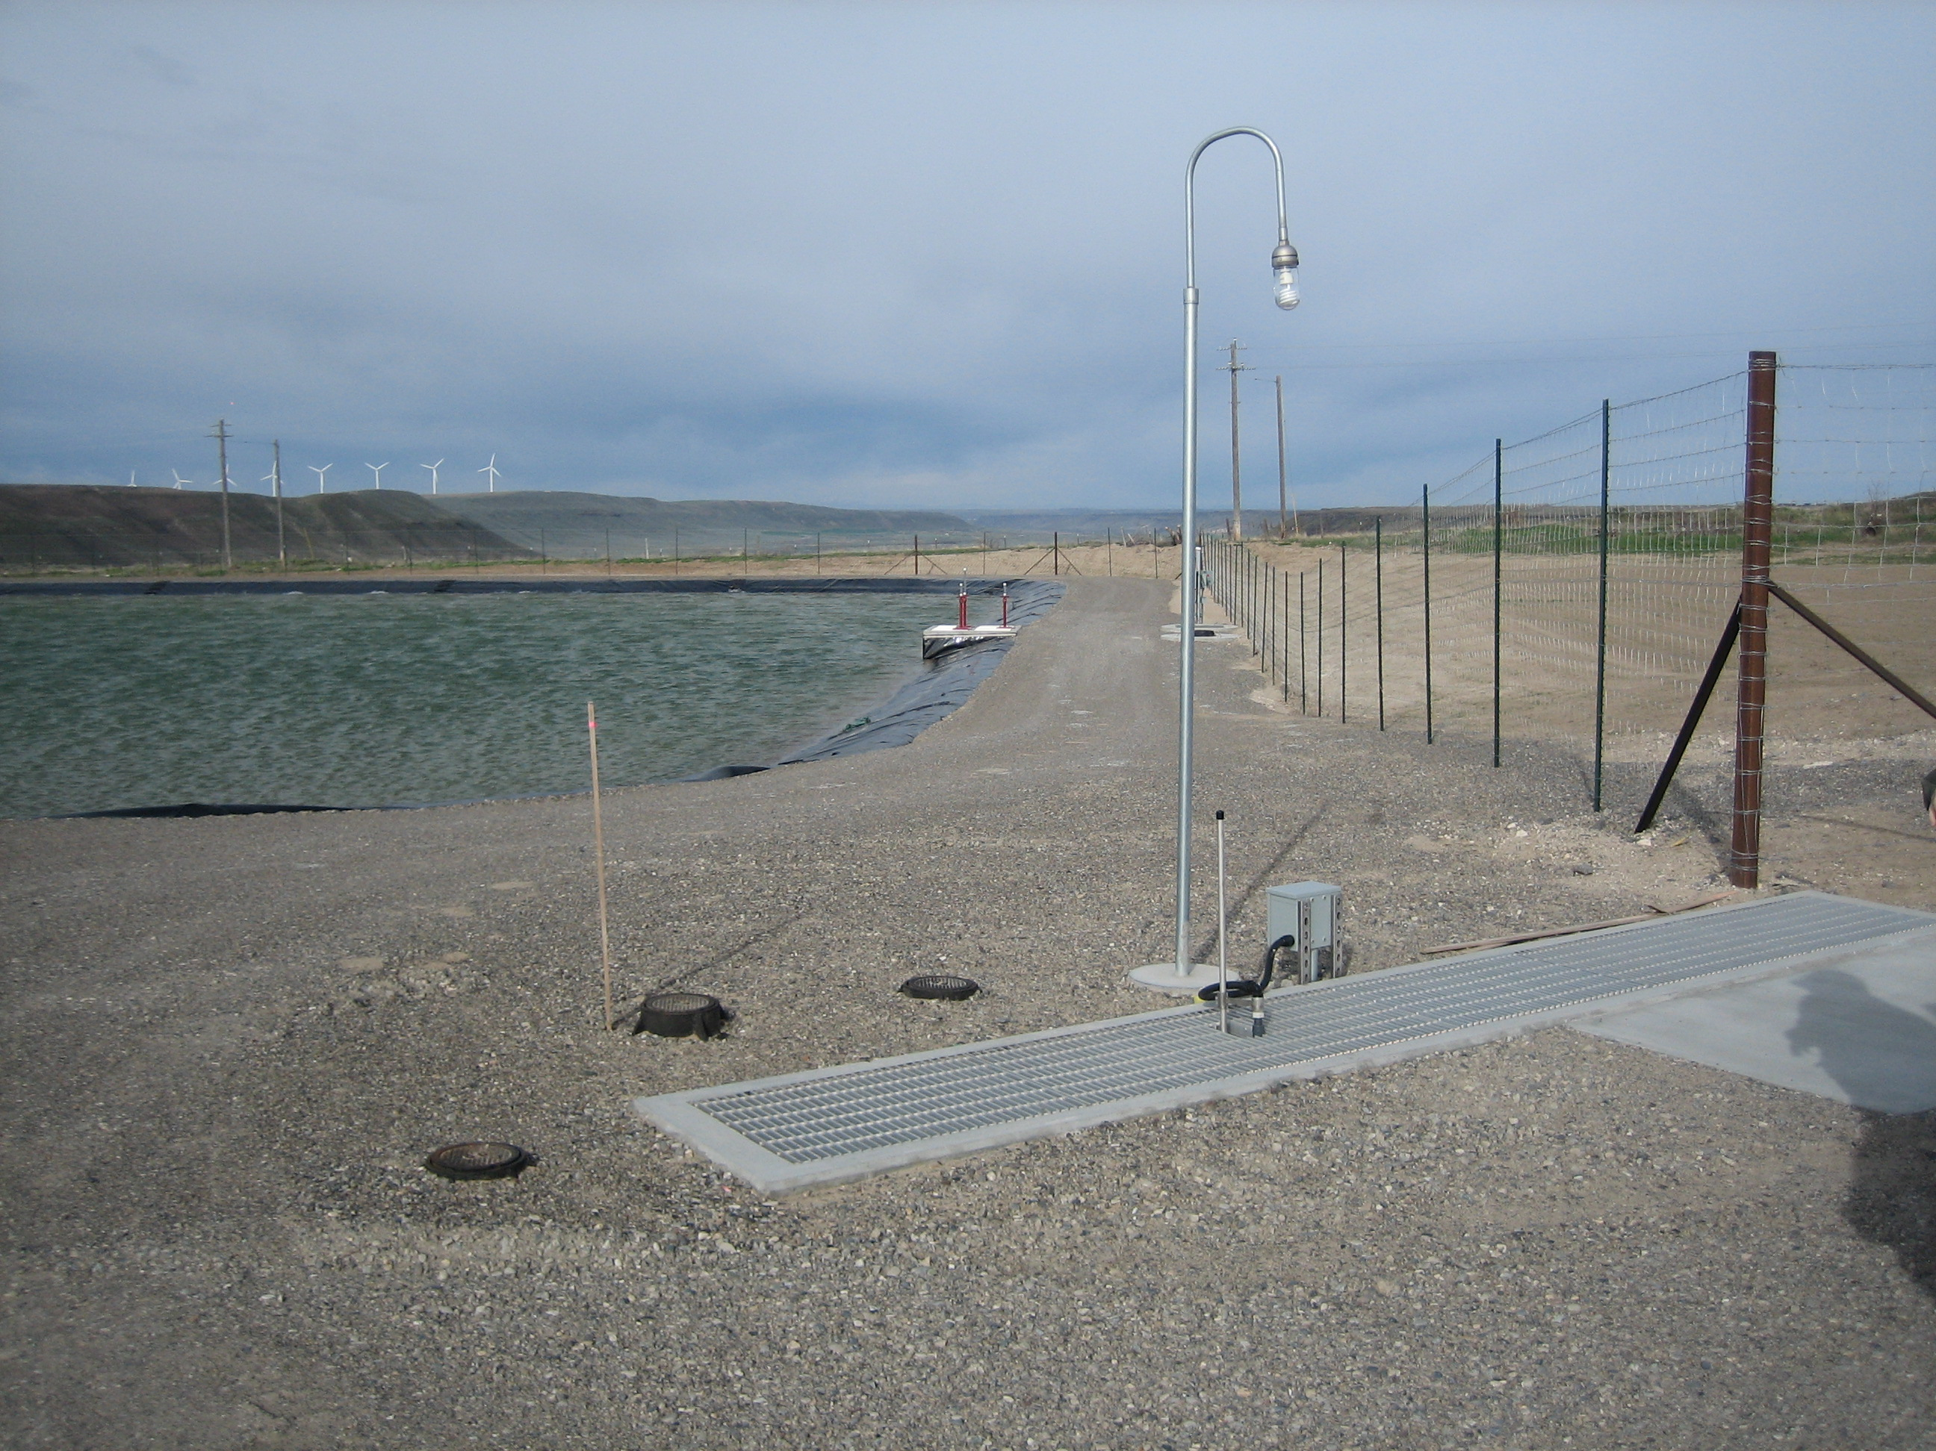
Joint Environmental Examples and Case Studies
City of Bliss
New total containment lagoons
SRF, HUD-CDBG, RD and Corps of Engineers funding
Adjacent land owner filed lawsuit (NIMBY)
All 4 Agency’s came to the same determination
Judge ruled in favor of the Agency’s
Strength in numbers!

Slide 5
Example: State level: Environmental Coordination
Benefits
Stronger Environmental Documents - shared team knowledge
Reduces Cost to Applicants – streamlined multiple agency review process
Reduces Staff time to review projects - shared resources
Multiple agencies united project implementation and determinations are stronger if challenged
BMP’s
Scoping meeting up front with all potential funding agencies
Quarterly coordination meetings
Publish joint notices when possible
Hold joint training sessions with other funding agencies
Copy SRF Engineers, SRF Environmental staff, Owner, Consulting Engineer and funders on all correspondence
Attend annual SRF Engineer & Environmental meetings
Continually work to streamline with other Agencies

